Slide 1

Hyper-Localization Strategy
Dominating the Louisville Market
CLIENT UPDATE MEETING
JANUARY 2026

Slide 2


Overcoming the Geographical Challenge
1
Google Map Pack rankings are heavily influenced by physical proximity to the searcher.
2
Competitors like Lou Vet have a direct Louisville address, giving them an inherent advantage.
3
Our strategy focuses on maximizing Relevance and Prominence to compensate.
4
Hyper-localization signals to Google that Dogwood is the primary choice for Louisville residents.
THE SOLUTION
Transform Dogwood from a "Prospect vet" into a "Louisville authority" through neighborhood-level SEO optimization.

Slide 3

The Hyper-Localization Framework
A three-pronged approach to building local authority
1
2
3
Technical SEO
On-Page Content
Local SEO Signals
LocalBusiness Schema implementation
•
Neighborhood landing pages
•
Neighborhood citations
•
Hyper-localized URL structures
•
Localized keyword targeting
•
Localized social proof
•
Site crawlability optimization
•
Landmark integration
•
Review strategy
•
This framework creates a "relevance shield" that protects and grows our ranking in target areas.

Slide 4

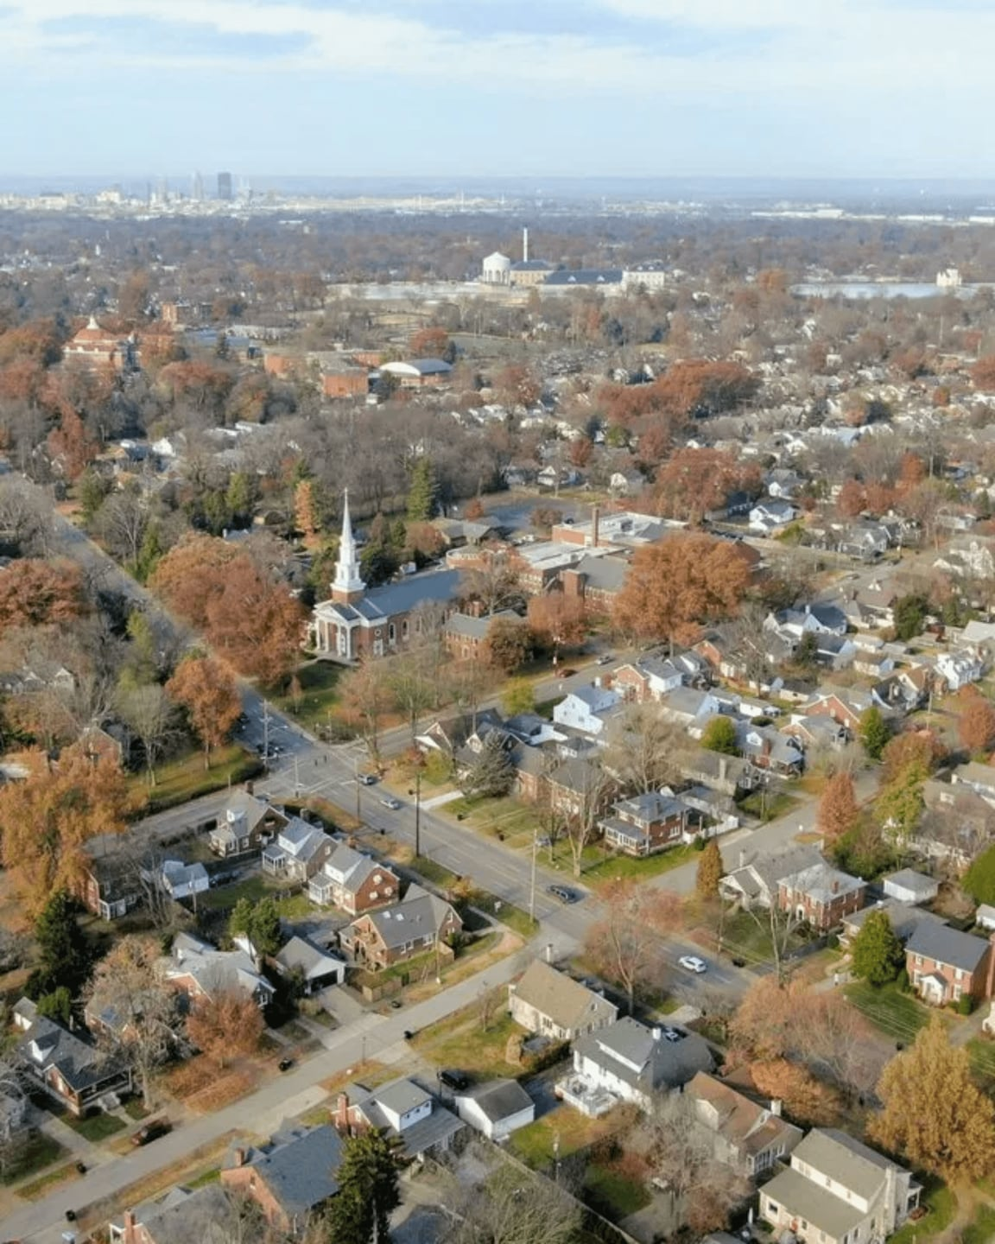
St. Matthews: Capturing the 40207 Market
STRATEGIC TARGETING OF AN AFFLUENT NEIGHBORHOOD
PRIMARY KEYWORDS
High-Intent Search Terms
"Veterinarian near St. Matthews KY" and "Pet dental care 40207" capture residents actively seeking local care.
LANDMARK INTEGRATION
Local Relevance Signals
Strategic mentions of Seneca Park, Shelbyville Road, and Chenoweth Lane signal local expertise to search engines.
POSITIONING STRATEGY
The "Short Drive" Advantage
Explicitly addressing the 15-minute commute from St. Matthews to Norton Commons as a worthwhile investment for superior care.
STRATEGIC GOAL
Position Dogwood as the premier alternative to established local clinics for St. Matthews residents seeking advanced veterinary expertise.

Slide 5

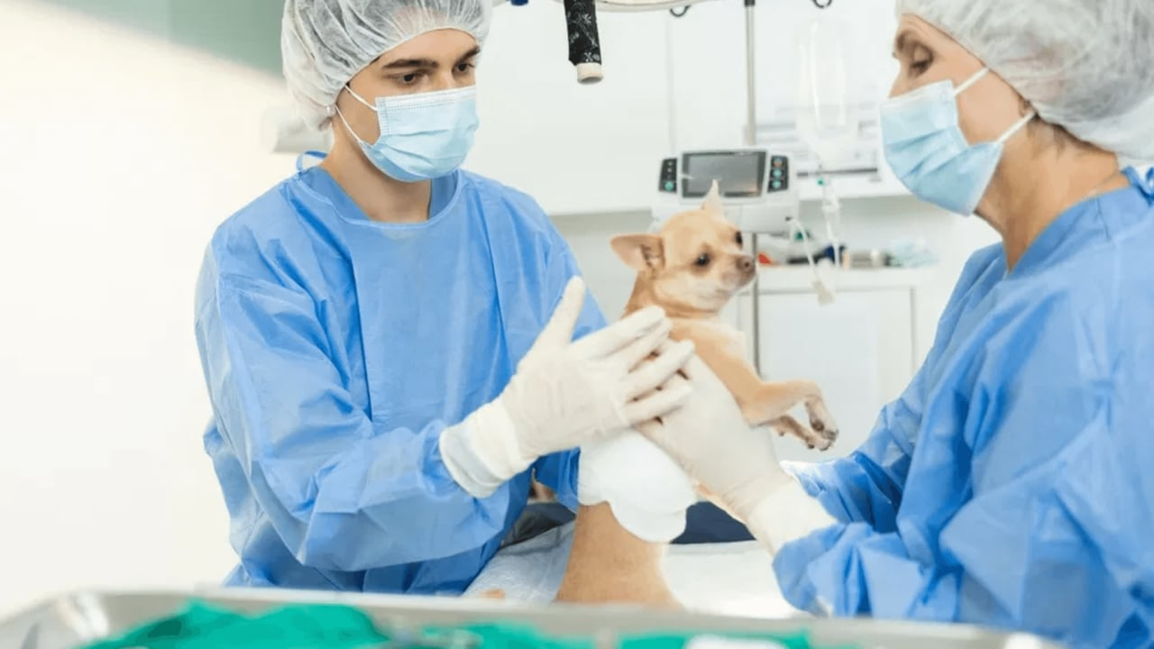

Middletown: Competing for Advanced Care
⚕
Surgical Expertise
Target pet surgery Middletown Louisville with advanced orthopedic and soft-tissue procedures.
💰
Transparent Pricing
Position as an affordable vet Middletown KY through wellness plans and clear cost structures.
🔬
Advanced Diagnostics
Emphasize state-of-the-art technology for accurate, efficient diagnosis and treatment planning.
👶
New Pet Owner Focus
Capture puppy vaccinations Middletown KY market with comprehensive wellness packages.
PRIMARY GOAL
Capture new pet owners and those seeking specialized care beyond general practice in the 40243 area.

Slide 6

Optimized URL & Content Structure
Sending clear, localized signals to search engine crawlers
URL Structure
Meta Descriptions
Recommended Pattern:
Format:
Include clinic name, location, primary service, and call-to-action within 160 characters
→
BASE URL
Example:
dogwoodvetclinic.com/veterinary-services-louisville-ky/[service-
"Looking for pet dental care in Louisville, KY? Dogwood Vet Clinic offers expert cleanings and oral surgery. Book your appointment today!"
name]/
Examples:
/veterinary-services-louisville-ky/pet-dental-care/
→
/veterinary-services-louisville-ky/orthopedic-dog-surgery/
→
Schema Markup (JSON-LD)
/louisville-ky/veterinarian-st-matthews/
→
LocalBusiness Schema on homepage and contact page
✓
Header Optimization
Explicit areaServed property listing Louisville neighborhoods
✓
H1 combines service + location (e.g., "Dental Care for Dogs in Louisville, KY")
✓
Service schema for each service page
✓
H2s use secondary keywords and neighborhood mentions
✓
Structured data helps Google understand service area and expertise
✓
Unique H1 on every page for maximum relevance
✓
Consistent header hierarchy across all pages
✓

Slide 7

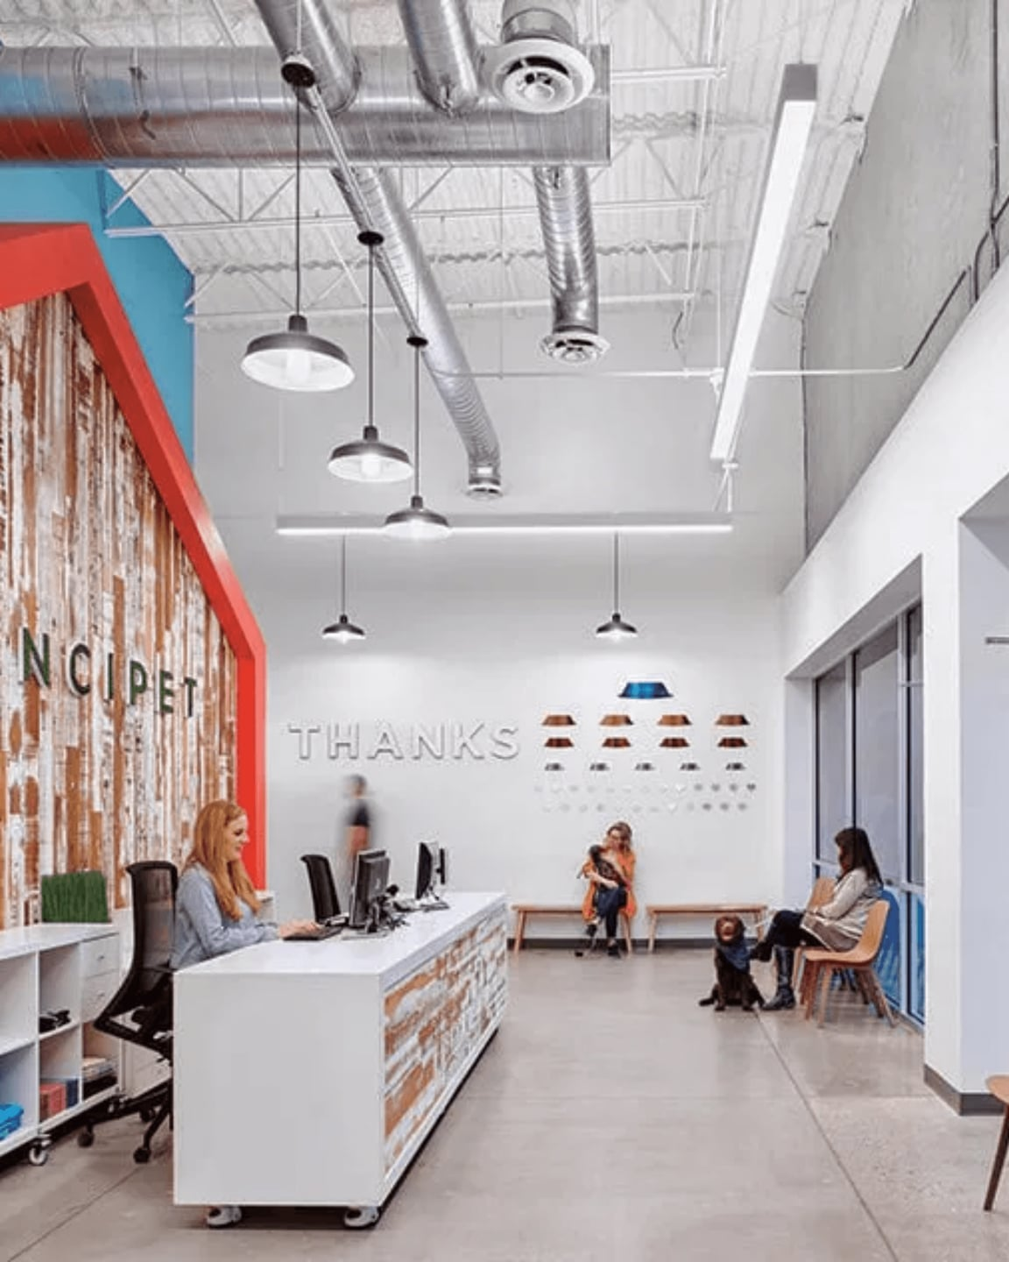
Implementation & Next Steps
1
PHASE 1: LAUNCH LANDING PAGES
Deploy St. Matthews and Middletown pages with full SEO optimization
Implement LocalBusiness Schema
→
Optimize meta tags and headers
→
2
PHASE 2: TECHNICAL INTEGRATION
Implement 301 redirects and update internal linking
Set up proper redirects from old URLs
→
Update homepage and blog internal links
→
3
PHASE 3: CITATION BUILDING
Aggressively build neighborhood-specific citations
Submit to top 50-100 local directories
→
Focus on Louisville business associations
→
4
PHASE 4: MONITOR & EXPAND
Track rankings and expand to additional neighborhoods
Monitor ranking improvements in GSC
→
Expand to Lyndon, Crestwood, and beyond
→
NEXT STEP
Finalize content implementation and begin Phase 1 rollout

Slide 8

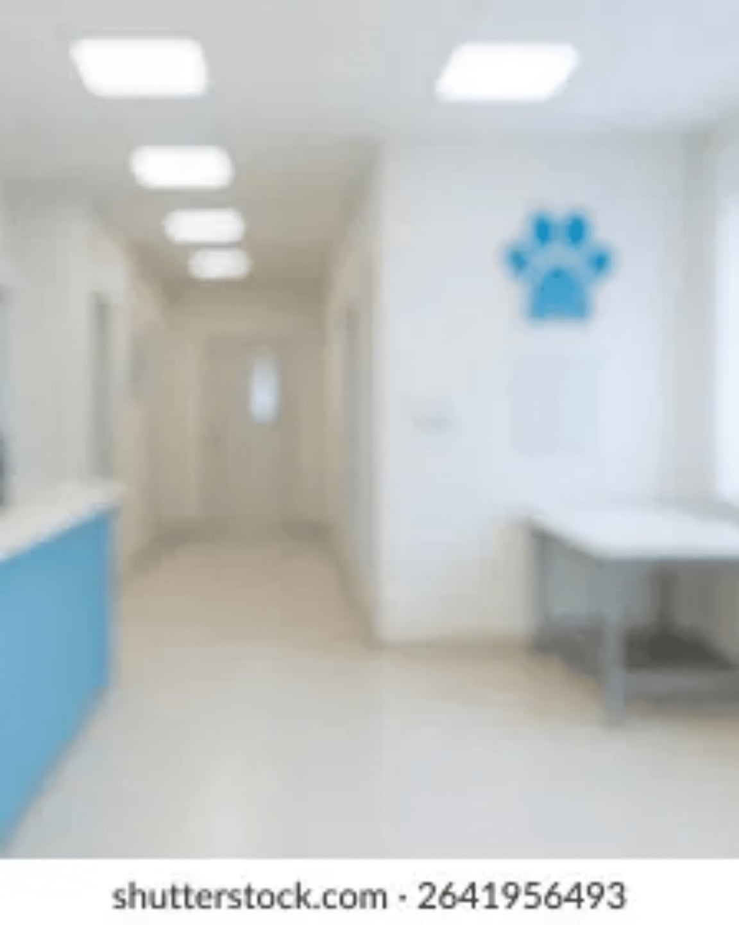
Building a Local SEO Powerhouse
✓
By focusing on neighborhood-level relevance, we bypass the proximity disadvantage.
✓
This strategy builds a sustainable competitive advantage that is difficult for competitors to replicate.
✓
We are transforming Dogwood Vet Clinic from a "Prospect vet" into a "Louisville authority."
✓
The result: Top 3 Google Map Pack rankings across multiple high-value neighborhoods.
NEXT STEP
Finalize content implementation and begin Phase 1 rollout.

